Slide 1


Final Presentation Digital Pre-Distortion
Students: Adir Cohen Nissan
Supervisor: Shai Ginzach, Dror Yachil
Semester: Spring, 2022-2023
Date: [10/05/23]
In collaboration with:

Slide 2
Outline
Project Goal
Theoretical background
Digital Pre Distortion
Classical methods
Neural Networks
Results
Discussion
Conclusions

Slide 3
Project Goal
Power amplifiers (PAs), are inherently nonlinear systems.
Nonlinearity causes in-band distortion and a spectral regrowth.
The role of the Digital Pre Distortion (DPD) is to distort the signal in a way that will be, in turn, compensated by the PA.

Slide 4
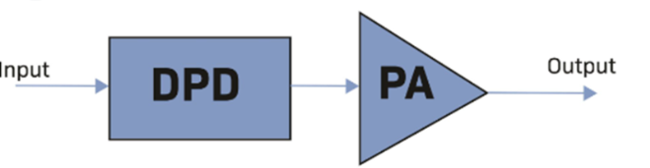
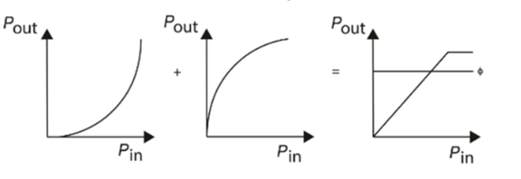
Project Goal

Slide 5
Project Goal
The aim of this project is that ideally, the total response of the Pre-distorter and PAs will be linear (reduce am/am, am/pm distortions and OOB emission) up to some saturation voltage.
Using both classical and deep learning methods, we will create a digital pre distorter that preprocess a signal before entering a nonlinear power amplifier.

Slide 6
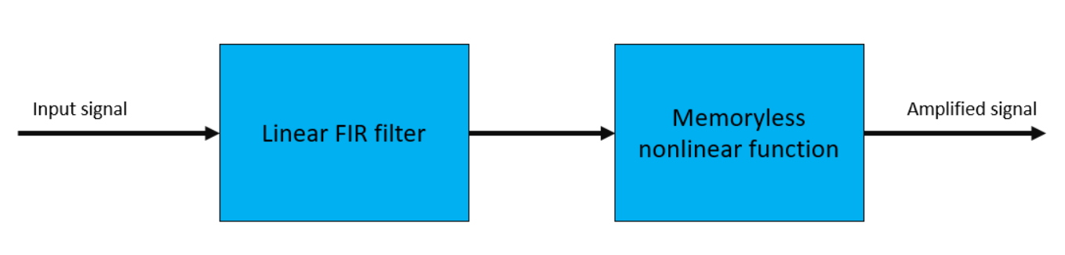
Background
Power amplifiers (PAs), are inherently nonlinear systems.
They are also exhibit memory effects.
Different models, such as the Wiener model and the Hammerstein model, represent this kind of system as a serial two-block model. [1]

Slide 7
Background
Different transmission formats, such as wideband Code Division Multiple Access (CDMA) or Orthogonal Frequency Division Multiplexing (OFDM), are known to have high peak to average power ratios.
That increases the risk of using voltages that are close to the PAs saturation point, as this will lead to a severe distortion, as mentioned above.
For this reason, PA linearization methods have gained popularity and increasing interest in recent years.
[2]

Slide 8
Background
The PA nonlinearity may be characterized in many ways.
In this work, we will concentrate on three types of distortions of the output signal
Amplitude Modulation/ Amplitude Modulation distortion (AM/AM)
Amplitude Modulation/ Phase Modulation distortion (AM/PM)
Out Of Band Emission (OOB emission)

Slide 9
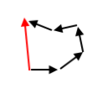

Methodology
In order to model a real PA, we used data recorded in our lab’s PA.
We took sampling rate of 10MHz, of about 60 tones, from a bandwidth of about 1MHz.

Slide 10
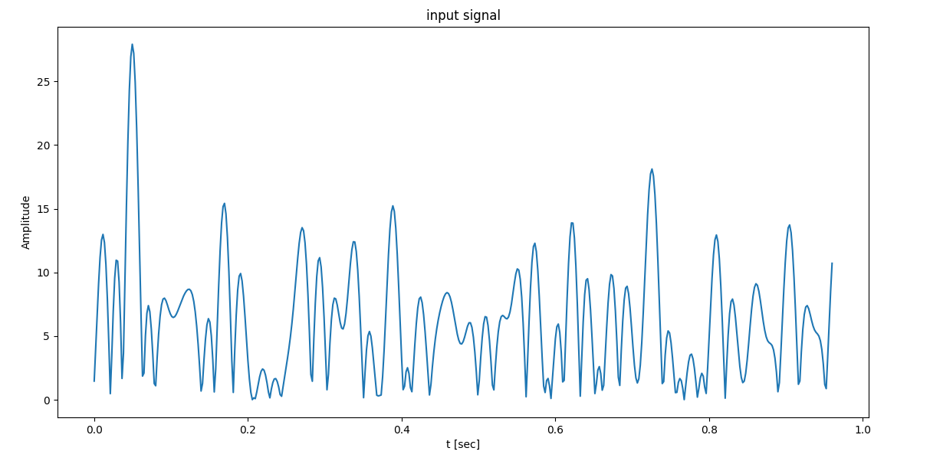

$$PAPR≈11 dB$$

Slide 11
AM/AM distortion
AM/AM is the relation between the amplitude of the input signal and the amplitude of the output signal.
Ideally, this relation should be linear, but due to non-linear components in the PA, is usually nonlinear

Slide 12
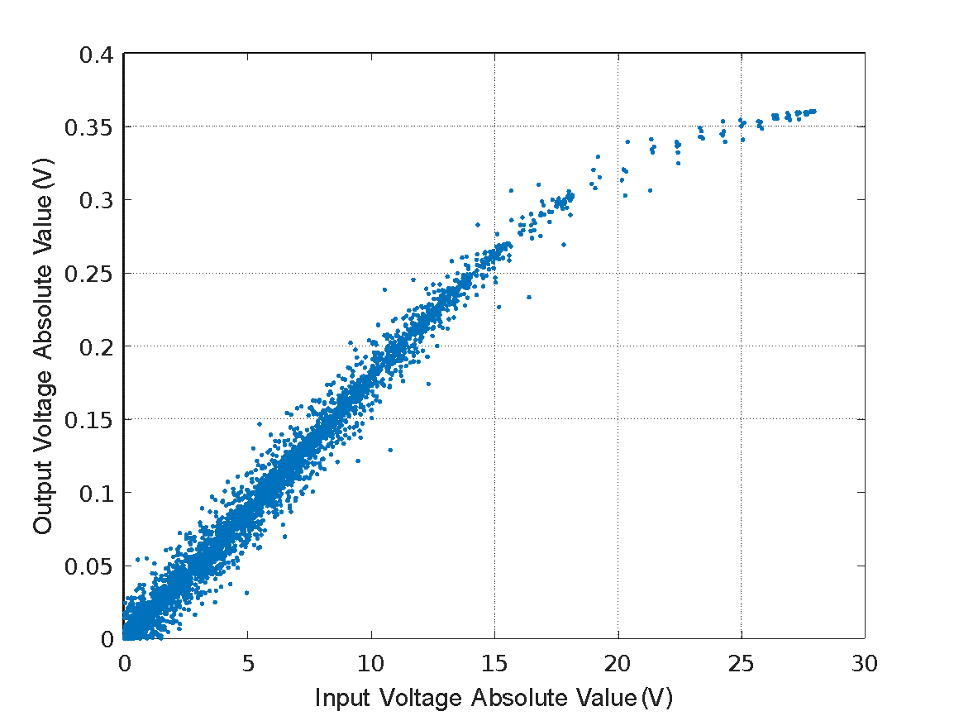
AM/AM distortion

Slide 13
AM/PM distortion
AM/PM is the relation between the amplitude of the input signal and the phase difference between the input signal and the output signal.
Ideally, the phase difference should not change while changing input amplitude.
Due to nonlinear affects, the deviation usually happens in the lower range of input signal amplitudes.

Slide 14
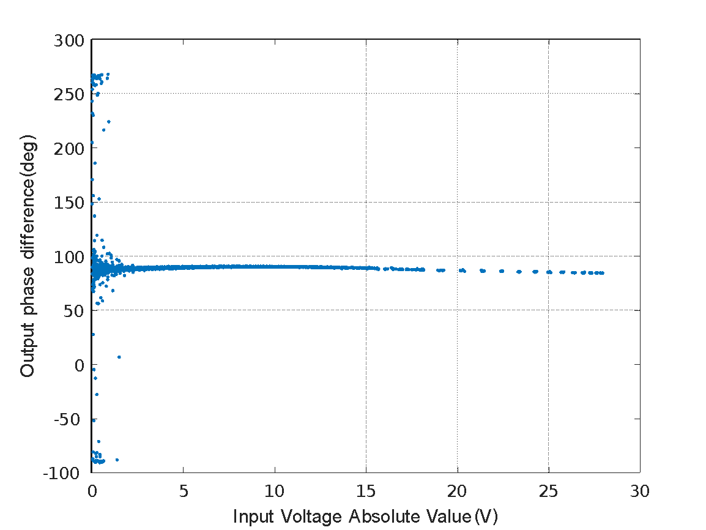
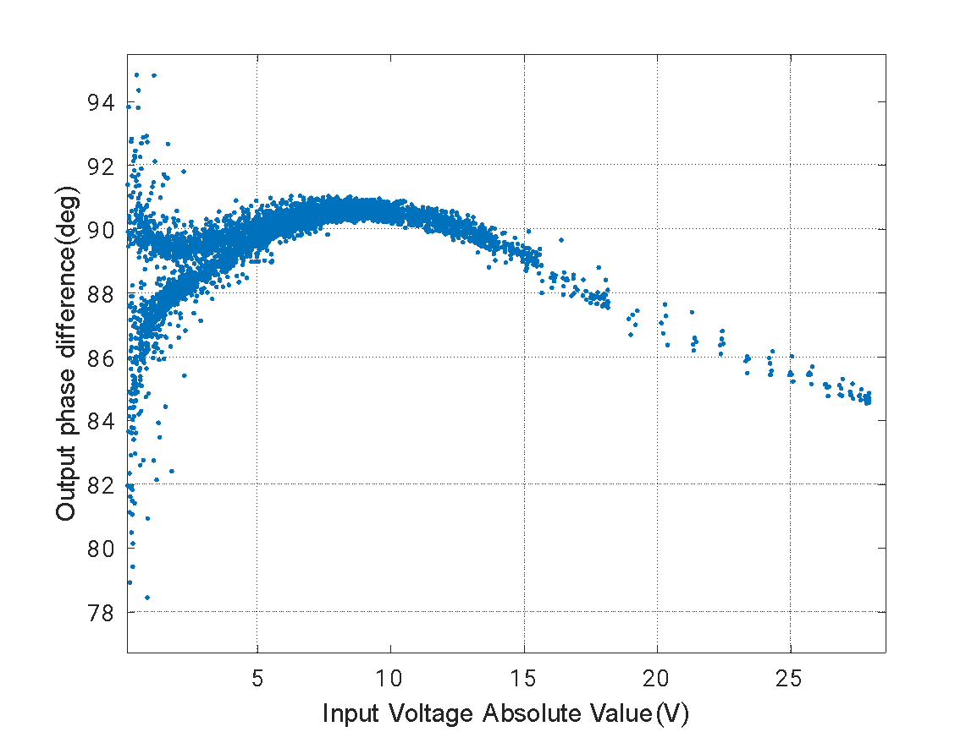
AM/PM distortion

Slide 15
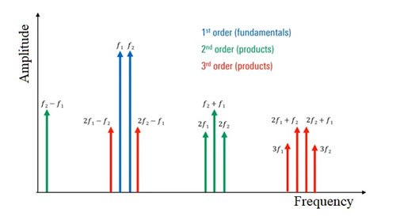
Out-Of-Band emission (OOB emission)
OOB emission is defined as the difference between the bandwidth of the signal after the PA and the bandwidth of the original signal.
It is a direct result of the nonlinearity of the PA.

Slide 16
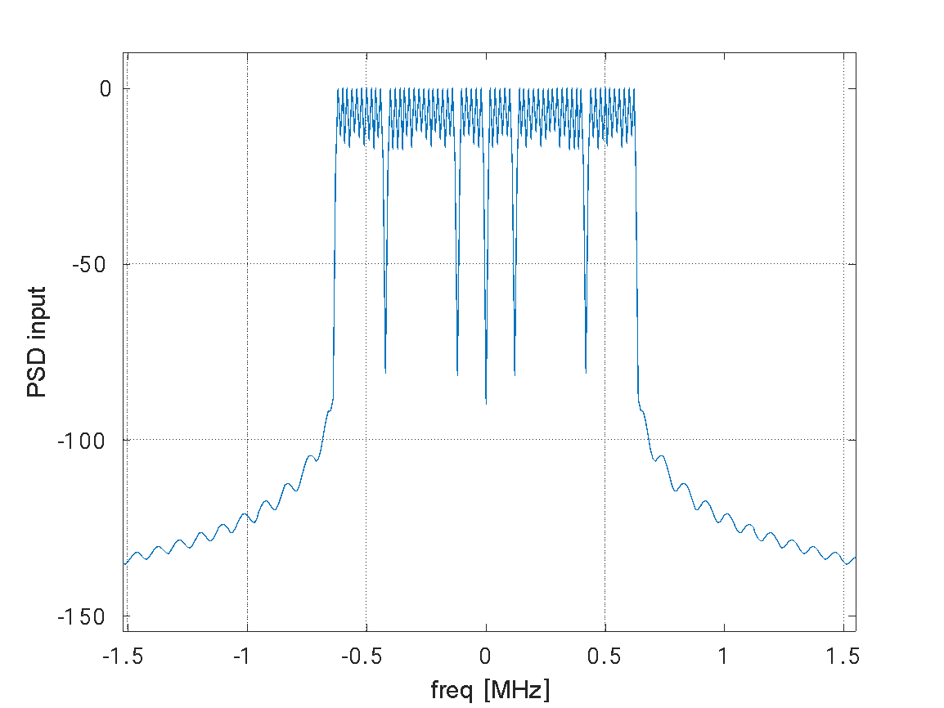
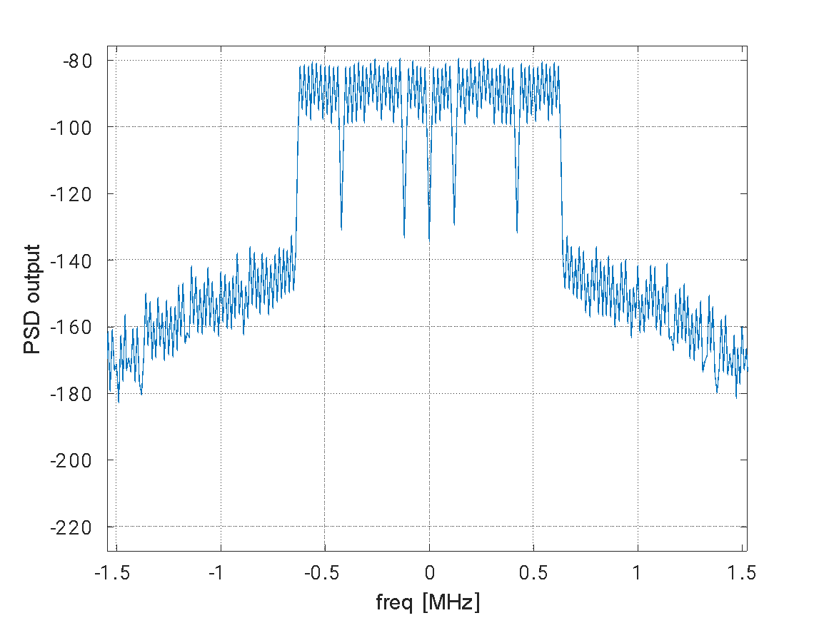
Out-Of-Band emission (OOB emission)

Slide 17
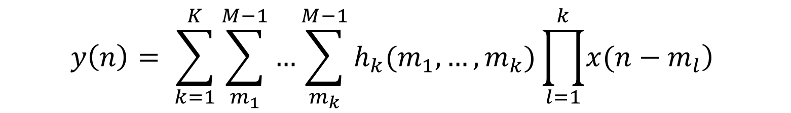
Volterra series as a PA model
Volterra series are used in order to model systems that are both nonlinear and have memory. [3]
$$y\left(n\right)= \sum_{k=1}^{K}{\sum_{m_{1}}^{M−1}{…}\sum_{m_{k}}^{M−1}{h_{k}(m_{1},…,m_{k})\prod_{l=1}^{k}{\left.x(n−m_{l}\right)}}}$$

Slide 18
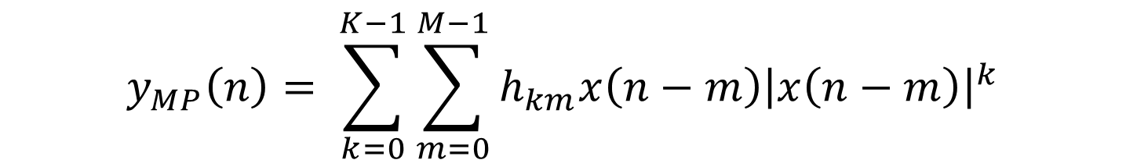
Memory Polynomial
Memory Polynomial model is a simplification of the full Volterra model, with less coefficients [3]
$$y_{MP}\left(n\right)= \sum_{k=0}^{K−1}{\sum_{m=0}^{M−1}{h_{km}x\left(n−m\right){\left|x\left(n−m\right)\right|}^{k}}}$$

Slide 19
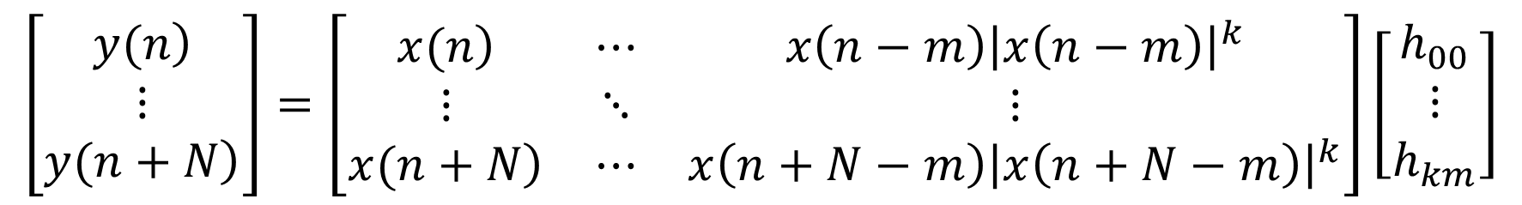

Matrix form
This model can be represented efficiently in matrix form as [3]:
$$y=Xθ_{MP}$$
$$\left[\begin{matrix}\left.y(n\right) \\ ⋮ \\ \left.y(n+N\right)\end{matrix}\right]=\left[\begin{matrix}\left.x(n\right) & ⋯ & x\left(n−m\right){\left|x\left(n−m\right)\right|}^{k} \\ ⋮ & ⋱ & ⋮ \\ \left.x(n+N\right) & ⋯ & x\left(n+N−m\right){\left|x\left(n+N−m\right)\right|}^{k}\end{matrix}\right]\left[\begin{matrix}h_{00} \\ ⋮ \\ h_{km}\end{matrix}\right]$$

Slide 20

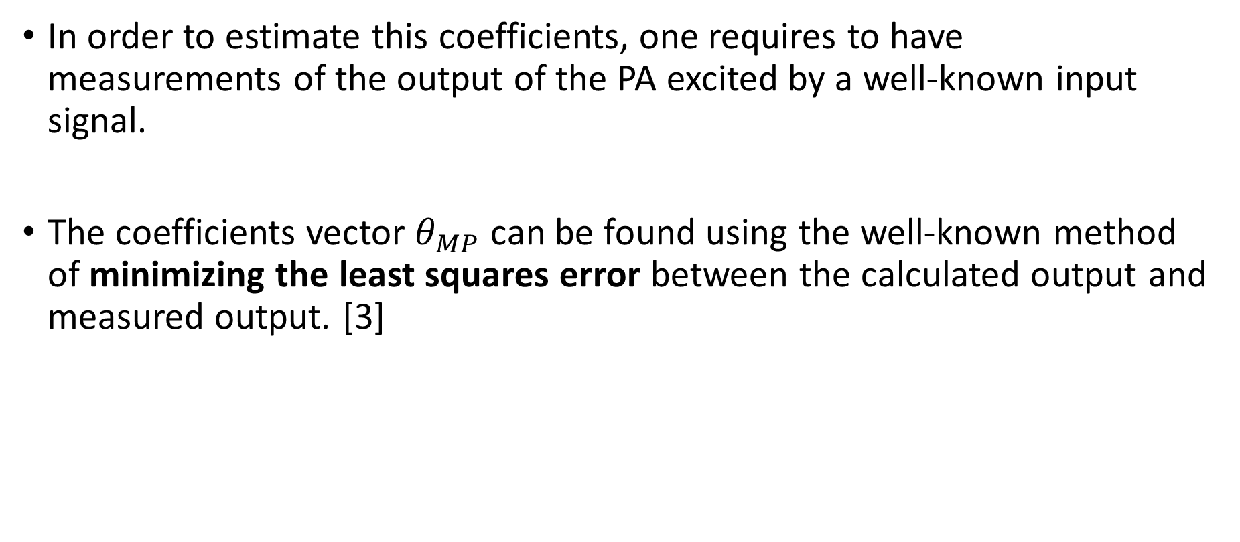
MSE
In order to estimate this coefficients, one requires to have measurements of the output of the PA excited by a well-known input signal.
The coefficients vector $θ_{MP}$ can be found using the well-known method of minimizing the least squares error between the calculated output and measured output. [3]
$${\hat{θ}}_{MP}={\left(X^{H}X\right)}^{−1} Xy$$

Slide 21

MSE
Another way to find the parameters that minimize the least squares error is using stochastic gradient descent.
NLMS
$$μ=α⋅{\left(X^{H}X+εI\right)}^{−1}$$
$${\hat{θ}}^{\left(n+1\right)}={\hat{θ}}^{\left(n\right)}−2μX^{H}\left(X{\hat{θ}}^{\left(n\right)}−y\right)$$

Slide 22
M and K of PA
In order to find the optimal coefficients for the MP model, it is essential to choose values of m and k which model PA optimally.
One should find values of m and k that minimize the error between calculated output generated by coefficients calculated with those specific m and k, and measured output.

Slide 23
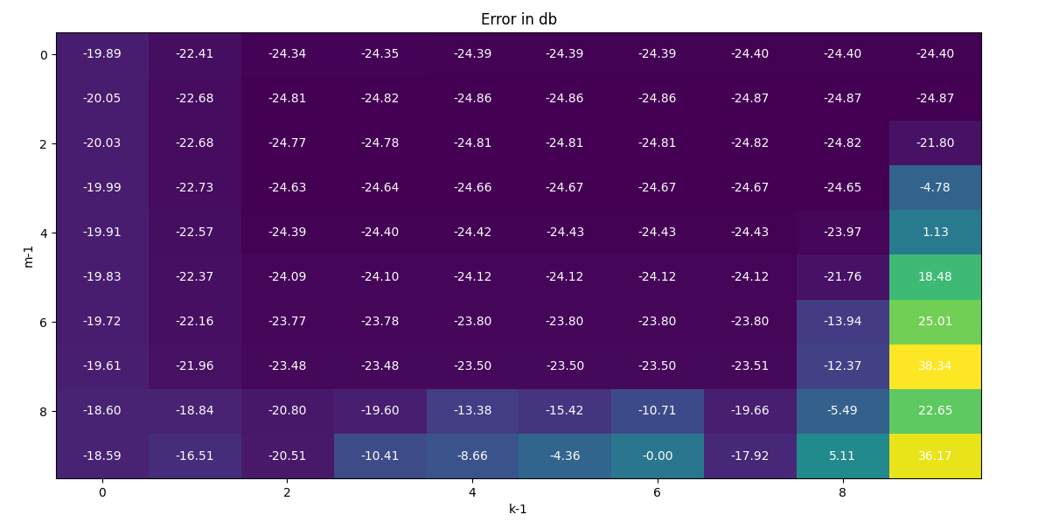
M=2 , K=9

Slide 24
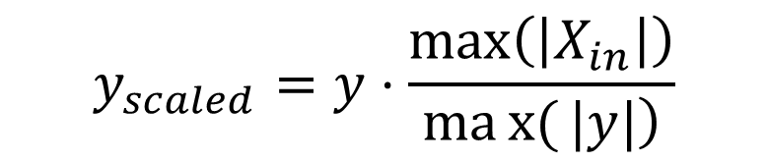
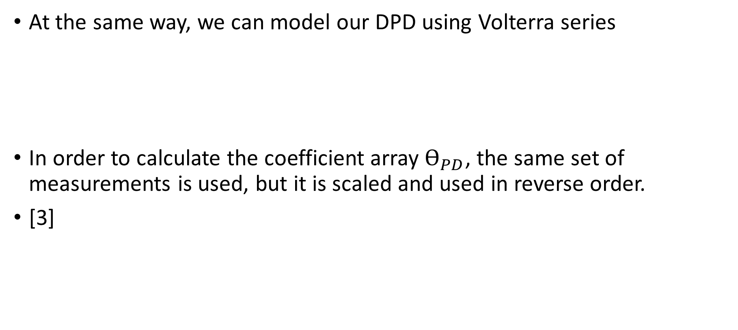

Volterra series as a DPD
At the same way, we can model our DPD using Volterra series
In order to calculate the coefficient array $Ѳ_{PD}$, the same set of measurements is used, but it is scaled and used in reverse order.
[3]
$$x=Yθ_{PD}$$
$$y_{scaled}=y⋅\frac{\max\left(\left|X_{in}\right|\right)}{\left.max{(}|y|\right)}$$

Slide 25
Volterra series as a DPD

Slide 26
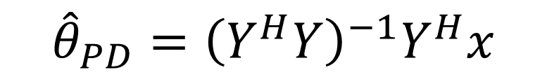
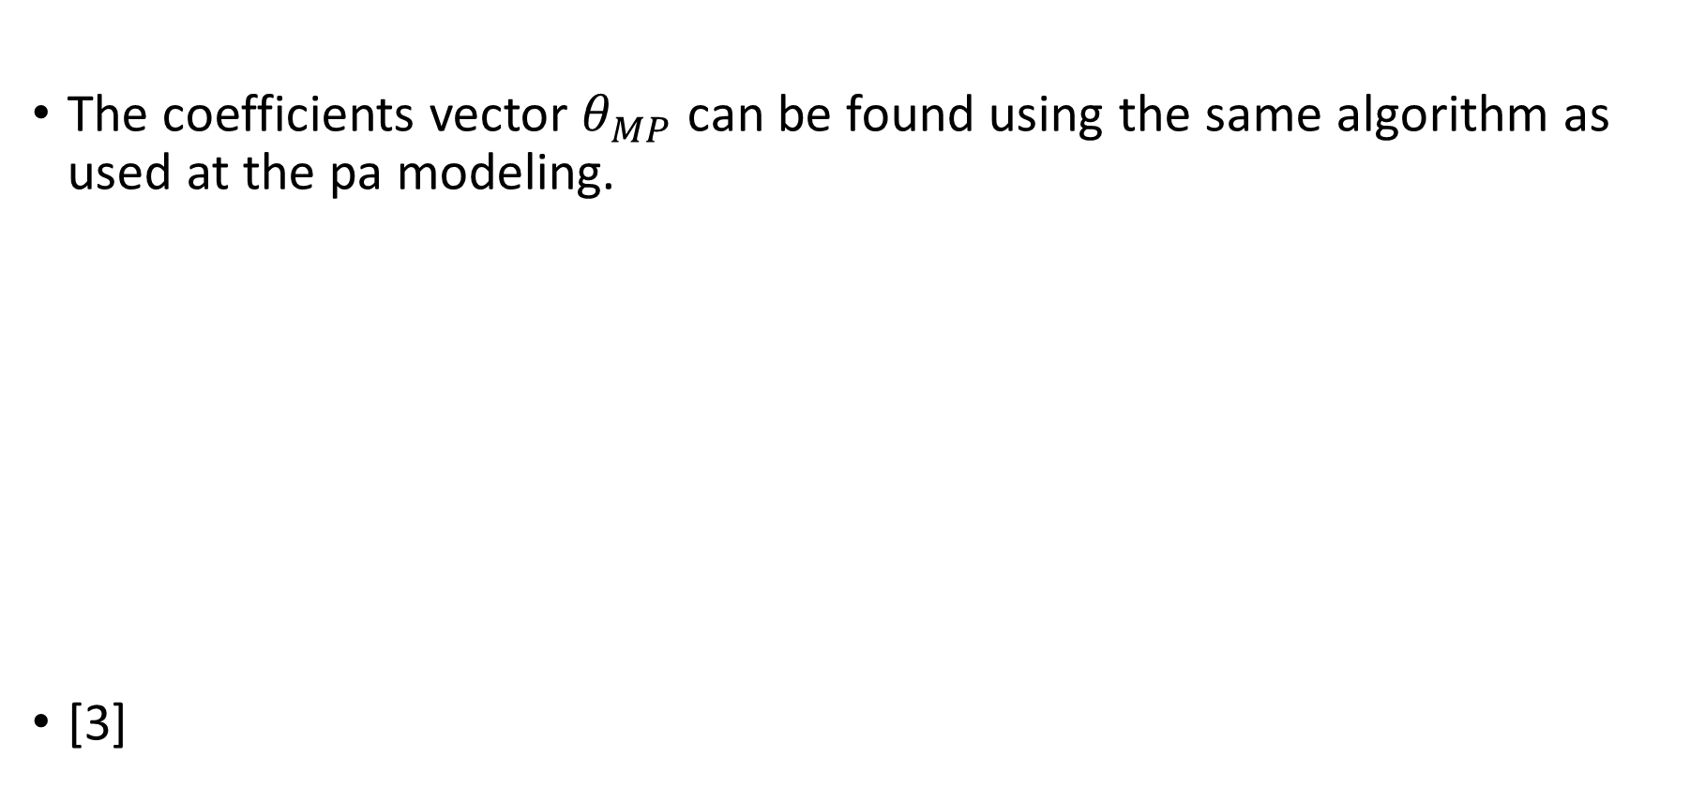
MSE
The coefficients vector $θ_{MP}$ can be found using the same algorithm as used at the pa modeling.
[3]
$${\hat{θ}}_{PD}={\left(Y^{H}Y\right)}^{−1}Y^{H}x$$

Slide 27
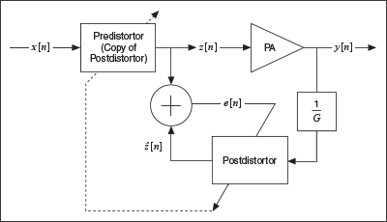


Volterra series as a DPD
$$z=Xθ_{PD}$$
$${\hat{θ}}_{PD}={\left(Y^{H}Y\right)}^{−1}Y^{H}z$$

Slide 28
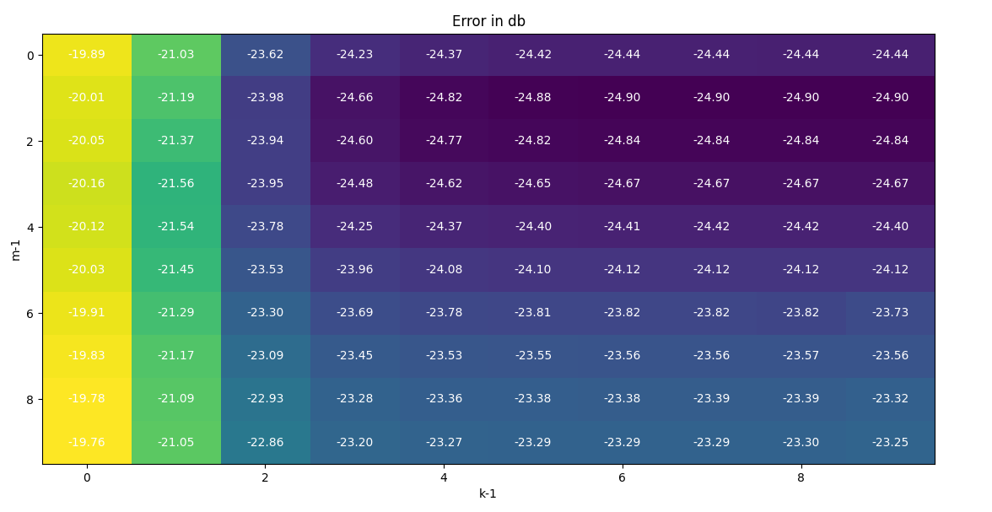
M=2 , K=9

Slide 29
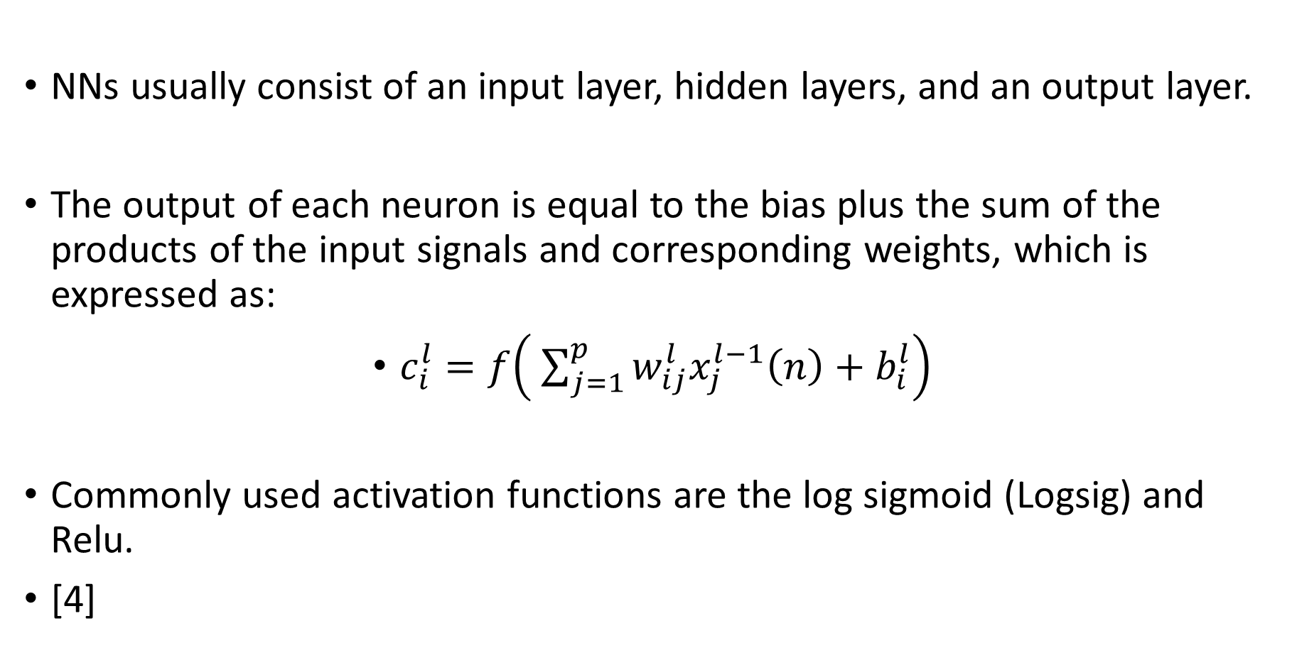
NN
NNs usually consist of an input layer, hidden layers, and an output layer.
The output of each neuron is equal to the bias plus the sum of the products of the input signals and corresponding weights, which is expressed as:
$c_{i}^{l}=f\left( \sum_{j=1}^{p}{w_{ij}^{l}x_{j}^{l−1}\left(n\right)}+b_{i}^{l}\right)$
Commonly used activation functions are the log sigmoid (Logsig) and Relu.
[4]

Slide 30
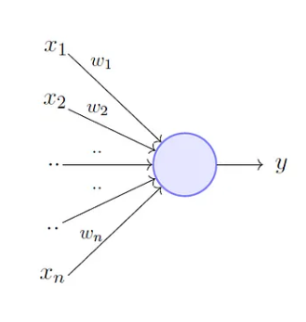
NN

Slide 31
NN
The values of the weights and biases are updated using a well-known type of the back-propagation algorithm
The cost function is then calculated again using the updated weights and biases during the next iteration.
Learning stops when the number of iterations reaches the maximum iterations allowed, or when the NN satisfies the desired performance in terms of MSE
[4]

Slide 32
Modeling a PA and a DPD with a NN
Due to their strong adaptive nature and approximation capability, NNs are very attractive for the behavioral modeling of PAs.
single-input single-output feedforward model
The main problem: this architecture requires the use of complex-valued weights and activation functions, which results in complicated calculations.
[4]

Slide 33
Modeling a PA and a DPD with a NN
Another proposed architecture is a polar feed forward NN, in which the network consist of two different NNs.
The first NN extracts the amplitude response of the PA output, and the second extracts the phase response.
The main problem: the two NN branches in this design usually cannot converge at the same time
[4]

Slide 34
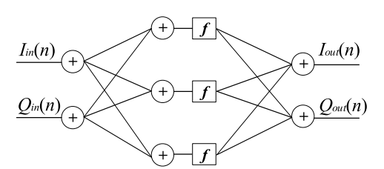
Modeling a PA and a DPD with a NN
another architecture has been proposed
The main problem: this architecture does not take into account memory effects.
[4]

Slide 35
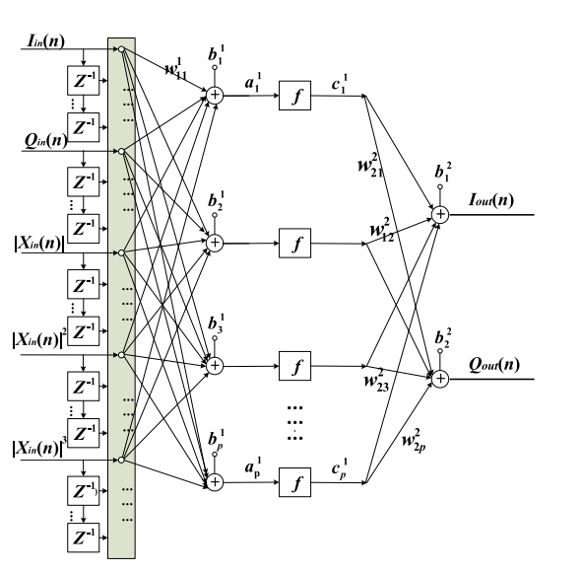
Chosen Solution
The proposed model in the article [4] is a combination of the above architectures

Slide 36
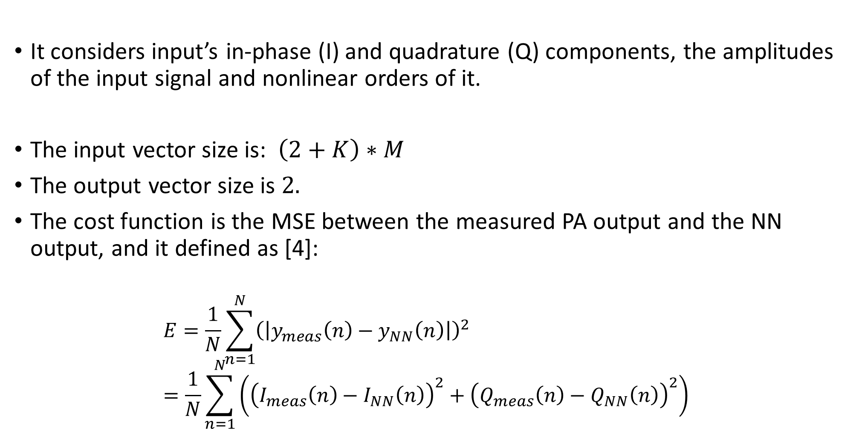
Chosen Solution
It considers input’s in-phase (I) and quadrature (Q) components, the amplitudes of the input signal and nonlinear orders of it.
The input vector size is: $\left(2+K\right)∗M$
The output vector size is $2.$
The cost function is the MSE between the measured PA output and the NN output, and it defined as [4]:
$$E=\frac{1}{N}\sum_{n=1}^{N}{{\left(\left|y_{meas}\left(n\right)−y_{NN}\left(n\right)\right|\right)}^{2}}=\frac{1}{N}\sum_{n=1}^{N}{\left({\left(I_{meas}\left(n\right)−I_{NN}\left(n\right)\right)}^{2}+{\left(Q_{meas}\left(n\right)−Q_{NN}\left(n\right)\right)}^{2}\right)}$$

Slide 37
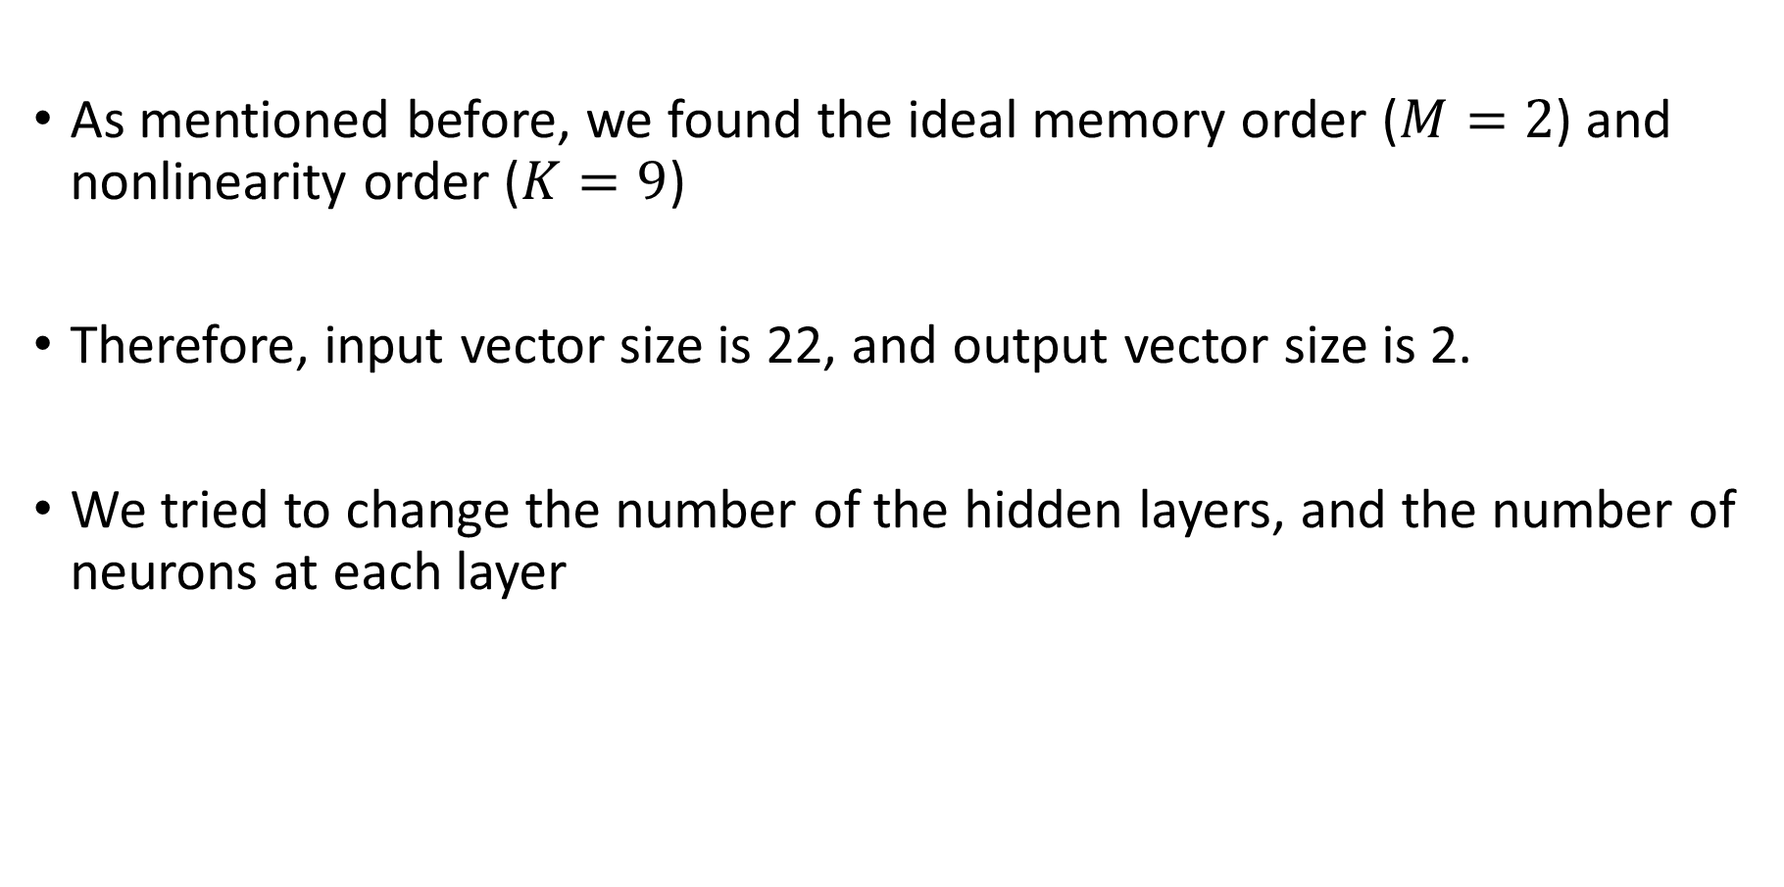
Chosen Solution
As mentioned before, we found the ideal memory order ($M=2$) and nonlinearity order ($K=9$)
Therefore, input vector size is 22, and output vector size is 2.
We tried to change the number of the hidden layers, and the number of neurons at each layer

Slide 38
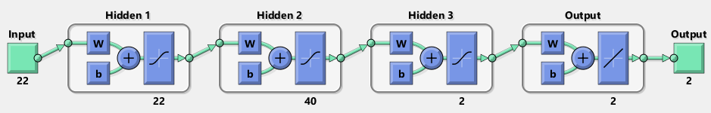
PA NN architecture

Slide 39
DPD NN architecture

Slide 40
Results
PA modeling

Slide 41
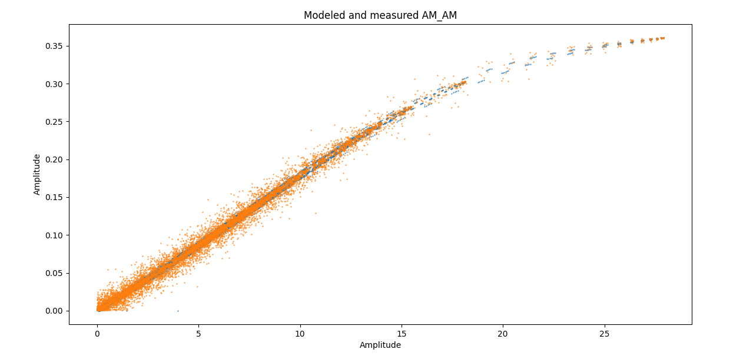
Classical - PA modeling
illustration of AM/AM distortion of input signal, caused by modeled PA, and real lab’s PA

Slide 42
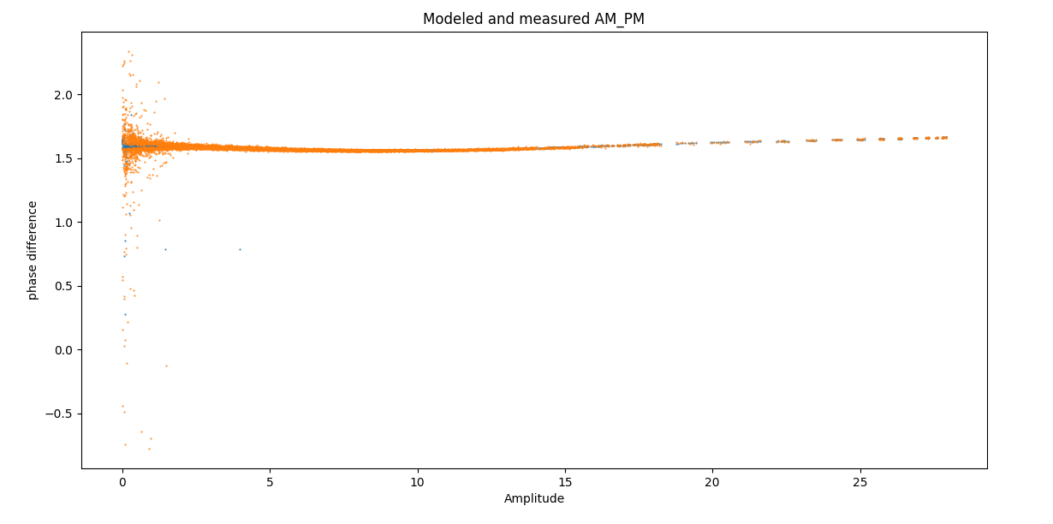
Classical - PA modeling
illustration of AM/PM distortion of input signal, caused by modeled PA, and real lab’s PA

Slide 43
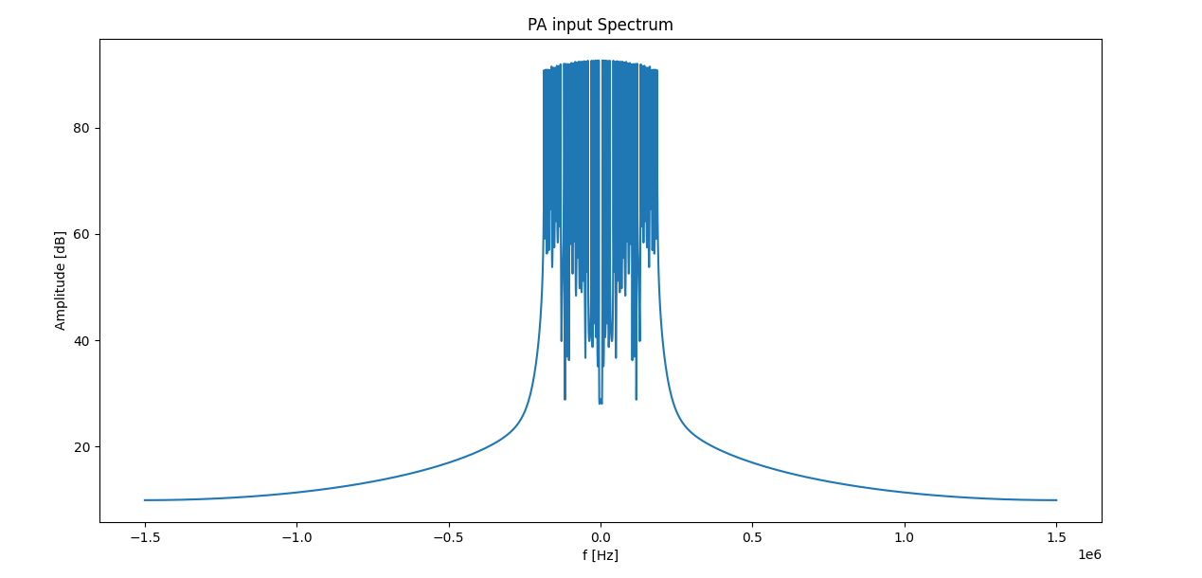
Classical - PA modeling
illustration of input signal spectrum

Slide 44
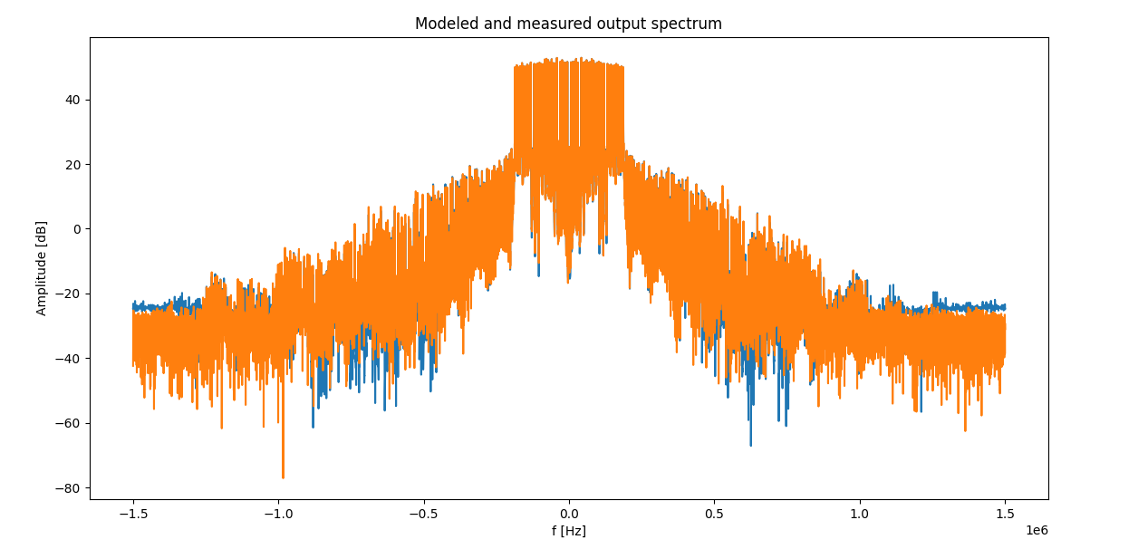
Classical - PA modeling
illustration of OOB emission caused by modeled PA, and real lab’s PA

Slide 45
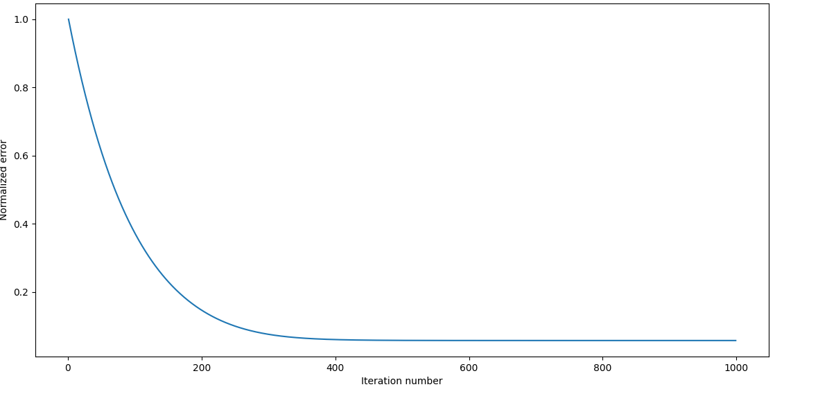
SGD
Normalized error between SGD modeled PA output and real Lab’s PA output

Slide 46
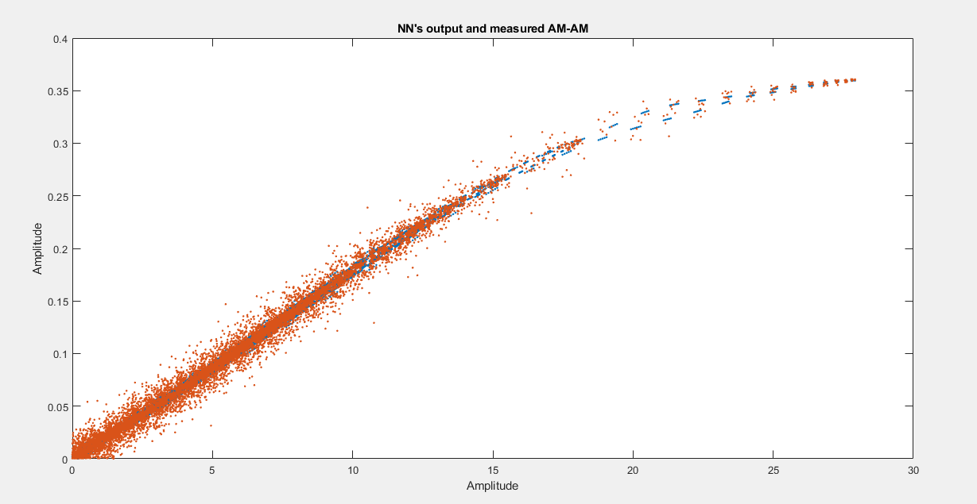
NN - PA modeling
illustration of AM/AM distortion of input signal, caused by feedforward (22-40-2) NN modelled PA in blue, and real lab’s PA in orange

Slide 47
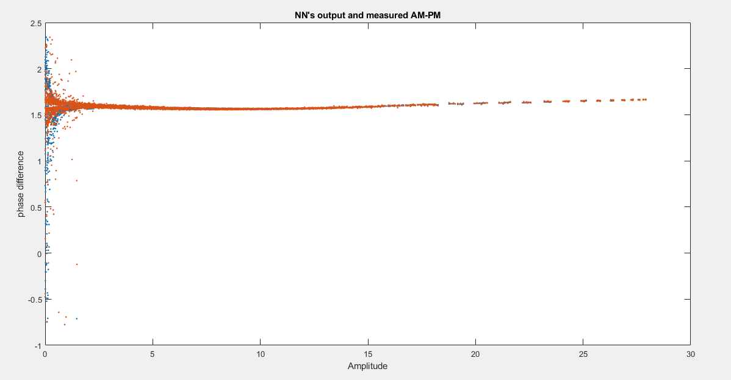
NN - PA modeling
illustration of AM/PM distortion of input signal, caused by feedforward (22-40-2) NN modelled PA in blue, and real lab’s PA in orange

Slide 48
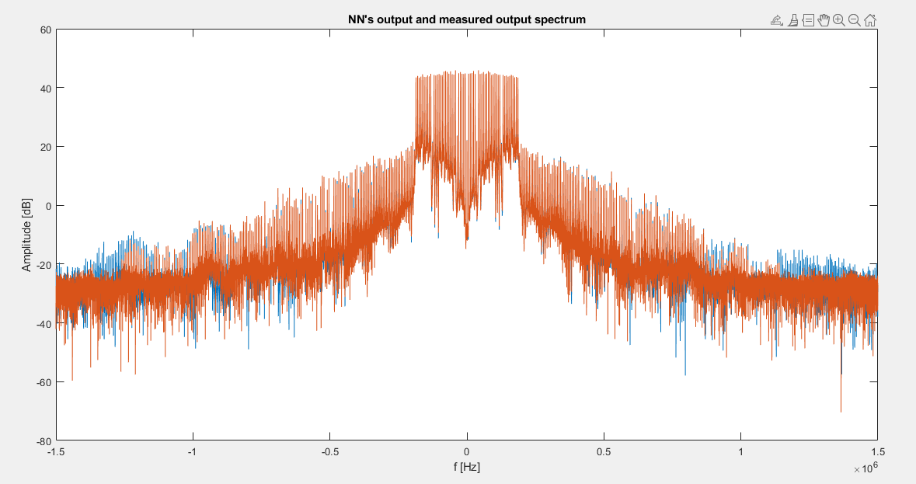
NN - PA modeling
illustration of OOB emission caused by feedforward (22-40-2) NN modelled PA in blue, and real lab’s PA in orange

Slide 49
Results
DPD

Slide 50
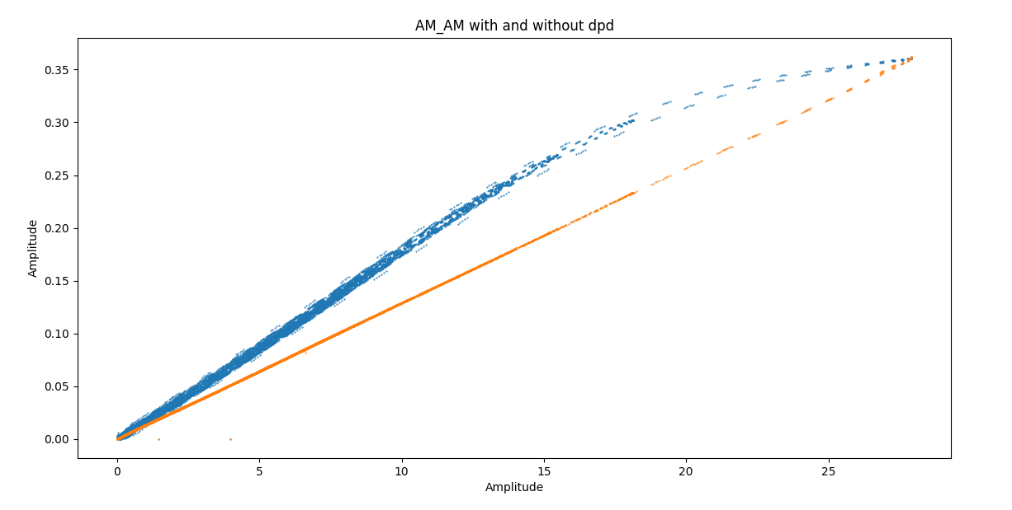
Classical - DPD
illustration of AM/AM distortion of input signal, with and without classical DPD

Slide 51
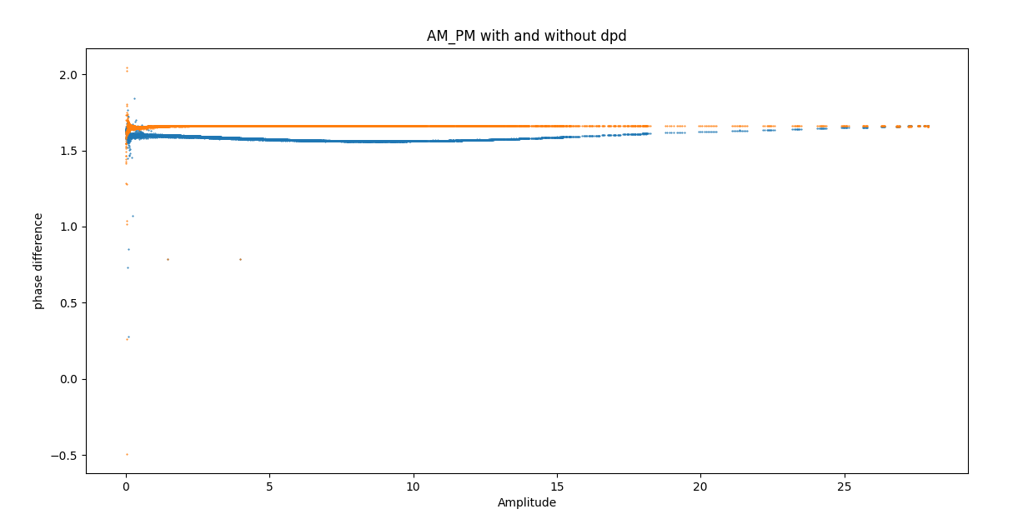
Classical - DPD
illustration of AM/PM distortion of input signal, with and without classical DPD

Slide 52
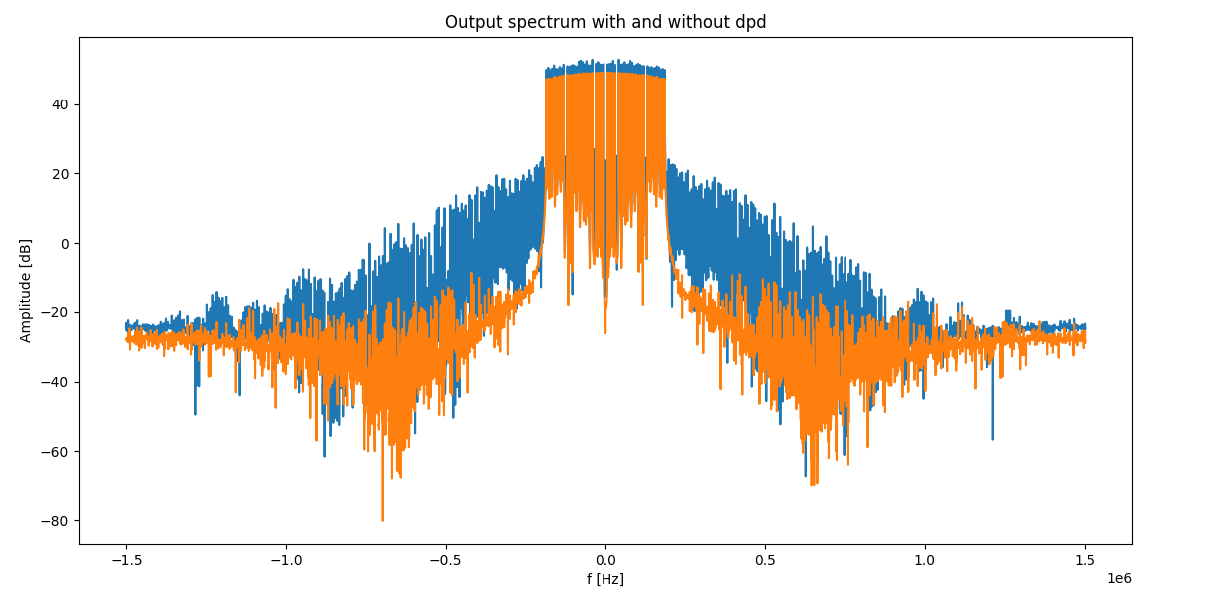
Classical - DPD
illustration of OOB emission caused by modeled PA, with and without classical DPD

Slide 53
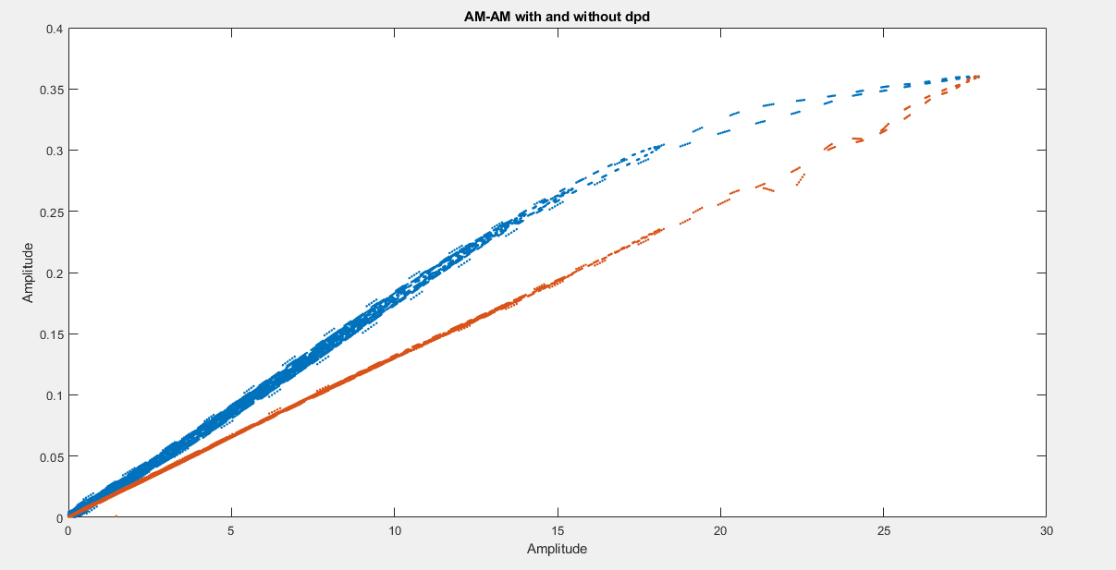
NN - DPD
illustration of AM/AM distortion of input signal, with (orange) and without (blue)
feedforward (22-30-40-30-20-10-2) NN modelled DPD

Slide 54
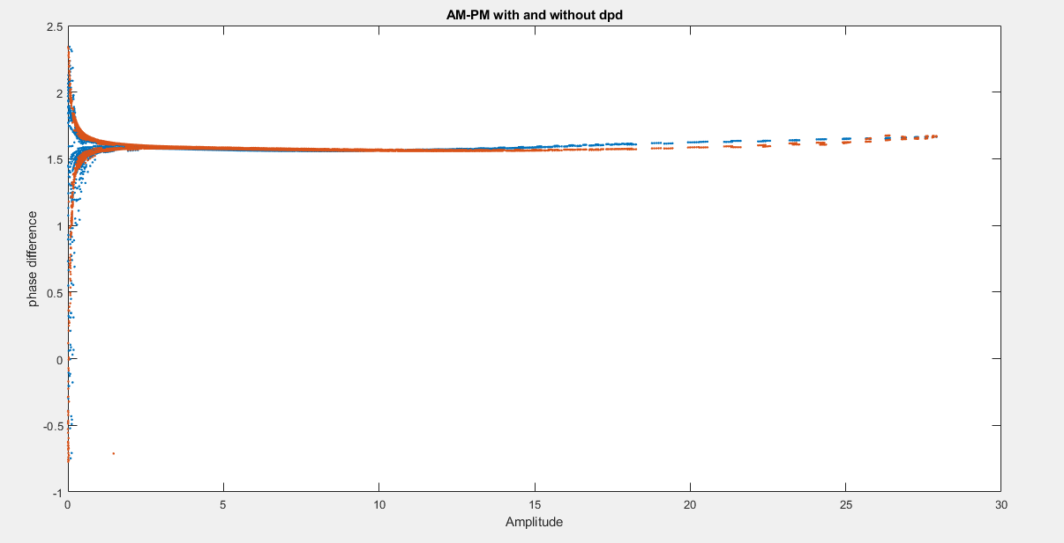
NN - DPD
illustration of AM/PM distortion of input signal, with (orange) and without (blue)
feedforward (22-30-40-30-20-10-2) NN modelled DPD

Slide 55
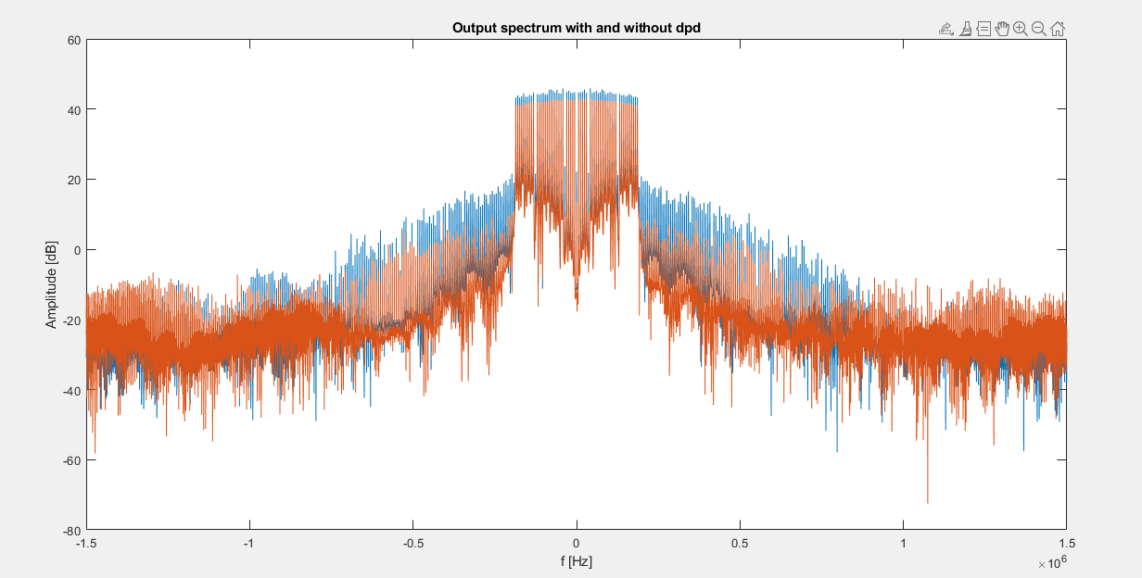
NN - DPD
illustration of OOB emission, with (orange) and without (blue)
feedforward (22-30-40-30-20-10-2) NN modelled DPD

Slide 56
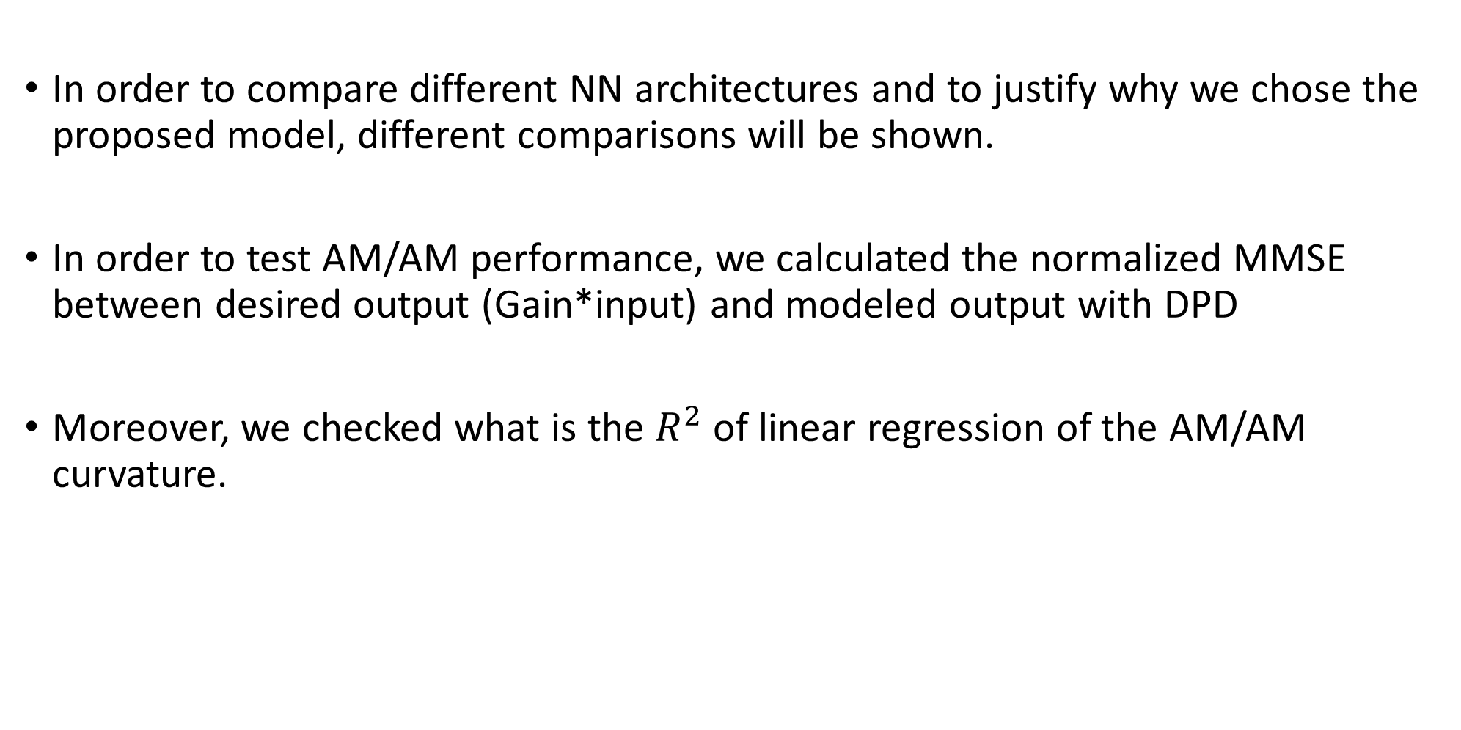
Comparisons with different models
In order to compare different NN architectures and to justify why we chose the proposed model, different comparisons will be shown.
In order to test AM/AM performance, we calculated the normalized MMSE between desired output (Gain*input) and modeled output with DPD
Moreover, we checked what is the $R^{2}$ of linear regression of the AM/AM curvature.

Slide 57
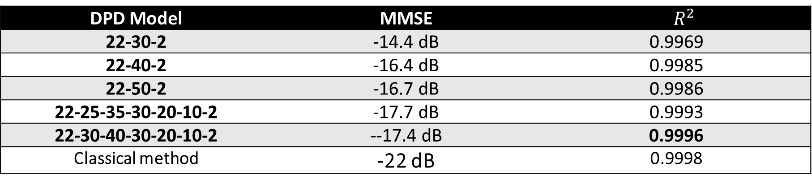
Comparisons with different models
DPD Model | MMSE | $$R^{2}$$
22-30-2 | -14.4 dB | 0.9969
22-40-2 | -16.4 dB | 0.9985
22-50-2 | -16.7 dB | 0.9986
22-25-35-30-20-10-2 | -17.7 dB | 0.9993
22-30-40-30-20-10-2 | --17.4 dB | 0.9996
Classical method | -22 dB | 0.9998
AM/AM performance for different DPD NN models. The proposed model has the most linear AM/AM curvature
It is clear that the proposed model does not give the minimal MMSE, but we chose it due to its linearity performance.

Slide 58
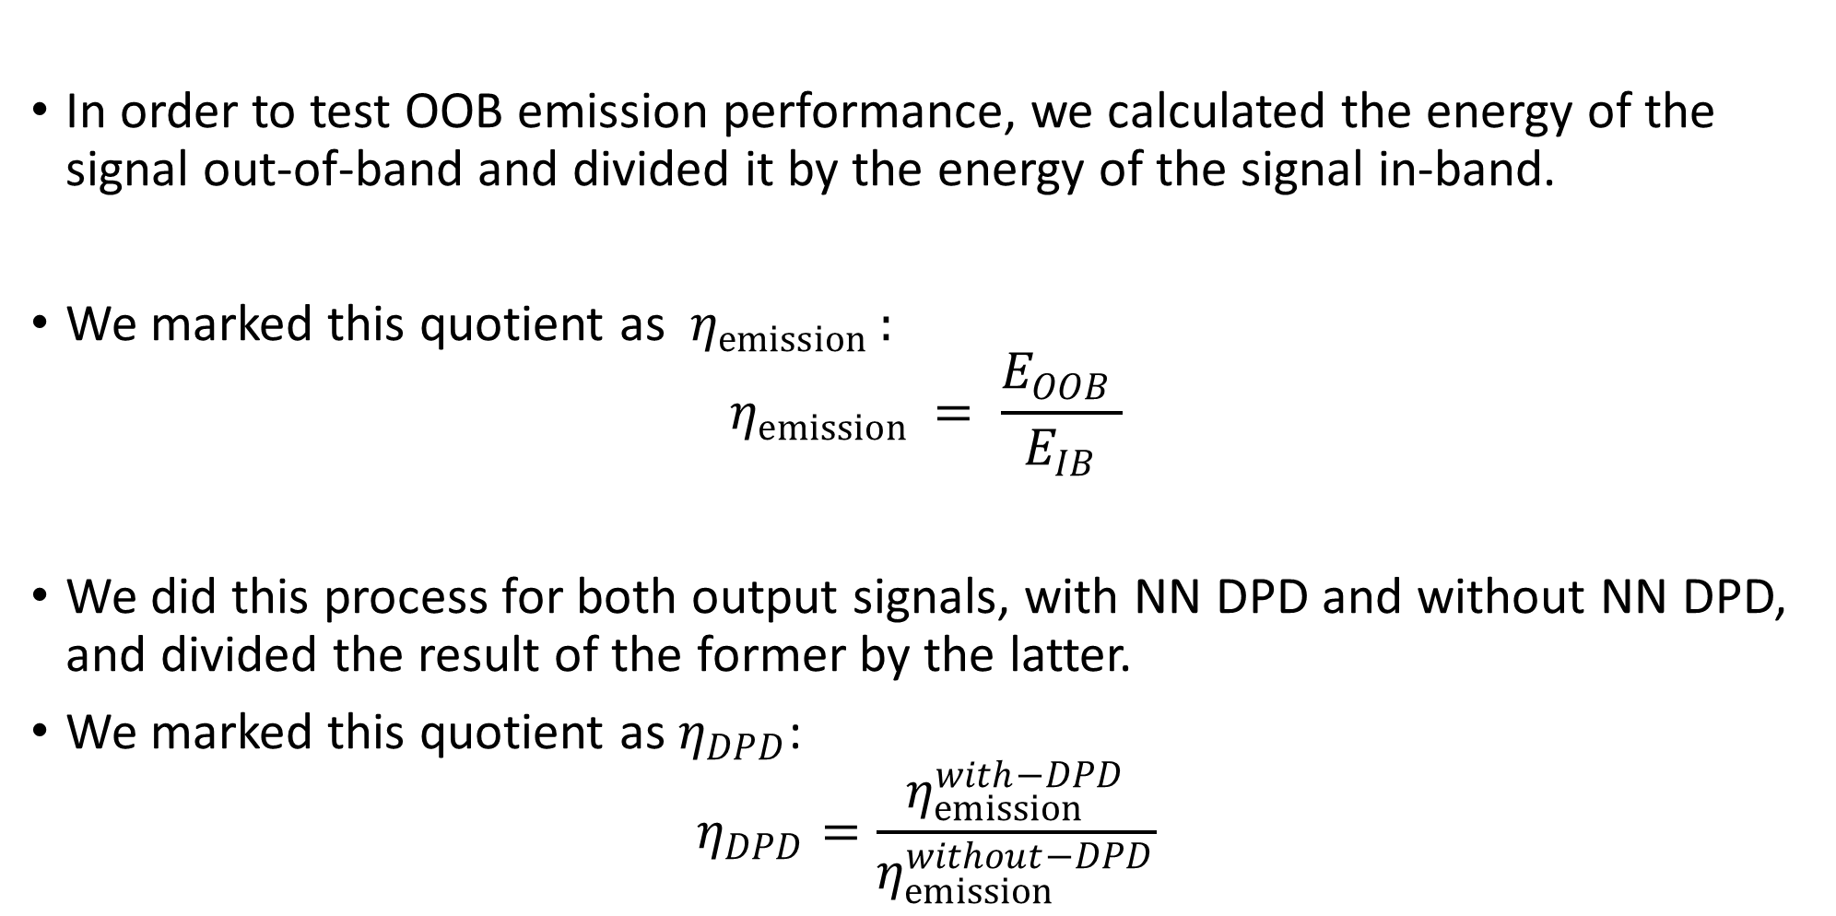
Comparisons with different models
In order to test OOB emission performance, we calculated the energy of the signal out-of-band and divided it by the energy of the signal in-band.
We marked this quotient as $η_{emission }:$
$$η_{emission }= \frac{E_{OOB }}{E_{IB}}$$
We did this process for both output signals, with NN DPD and without NN DPD, and divided the result of the former by the latter.
We marked this quotient as $η_{DPD}$:
$$η_{DPD}=\frac{η_{emission }^{with−DPD}}{η_{emission }^{without−DPD}}$$

Slide 59
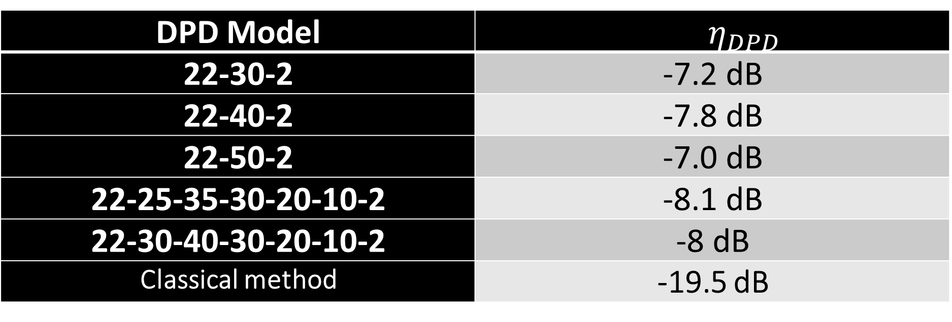

Comparisons with different models
DPD Model | $$η_{DPD}$$
22-30-2 | -7.2 dB
22-40-2 | -7.8 dB
22-50-2 | -7.0 dB
22-25-35-30-20-10-2 | -8.1 dB
22-30-40-30-20-10-2 | -8 dB
Classical method | -19.5 dB
OOB emission performance for different DPD NN models
It is clear that the proposed model does not gives the minimal$η_{DPD},$but we chose it due to it’s linearity performance.

Slide 60
Conclusion
The methods described in this report can model a real power amplifier and a digital pre distorter that their total response together will be, approximately, linear
For this purpose, we used both classical and based on Neural Network methods.
proposed classical model outperforms every other model.
Therefore, classical methods should be considered and tested seriously before using NN solutions.

Slide 61
Conclusion
We have shown that although MMSE is a convenient cost function for training, it doesn’t necessarily indicates about the linearity of the model.
Yet, we used data that contains relatively low content of high power, and was relatively narrowband.
Therefore, in the future this methods should be examined in the communication lab with more suitable measurements.

Slide 62
References
[1] Fadhel M.Ghannouchi, Oualid Hammi, Mohamad Helaoui, “Behavioral Modeling And Predistortion Of Wideband Wireless Transmitters”, Chichester, United Kingdom, John Wiley & Sons Ltd, 2015, pp. 115-116.
[2] Lei Ding, “Digital Predistortion of Power Amplifiers for Wireless Applications”, 2004, ProQuest Information and Learning Company, Ann Arbor, MI, pp. 1-4
[3] Z. Dunn, M. Yeary, C. Fulton, N. Goodman, “Memory Polynomial Model for Digital Predistortion of Broadband Solid-State Radar Amplifiers”, in 2015 IEEE Radar Conference (RadarCon), IEEE, 2015, pp. 1482-1486.
[4] Dongming Wang , Mohsin Aziz, Mohamed Helaoui, and Fadhel M. Ghannouchi, “Augmented Real-Valued Time-Delay Neural Network for Compensation of Distortions and Impairments in Wireless Transmitters”, IEEE Transactions on Neural Networks and Learning Systems, vol. 30, no. 1, pp. 242-254, 2019.

